Slide 1
Dinitz’ Algorithm
The Original Version and Even’s version
Yefim Dinitz
Dept. of Computer Science, Ben-Gurion University of the Negev, Beer-Sheva 84105, Israel
Dinitz@ca.bgu.ac.il
R36111193
王怡晶

Slide 2
Max flow

Slide 3
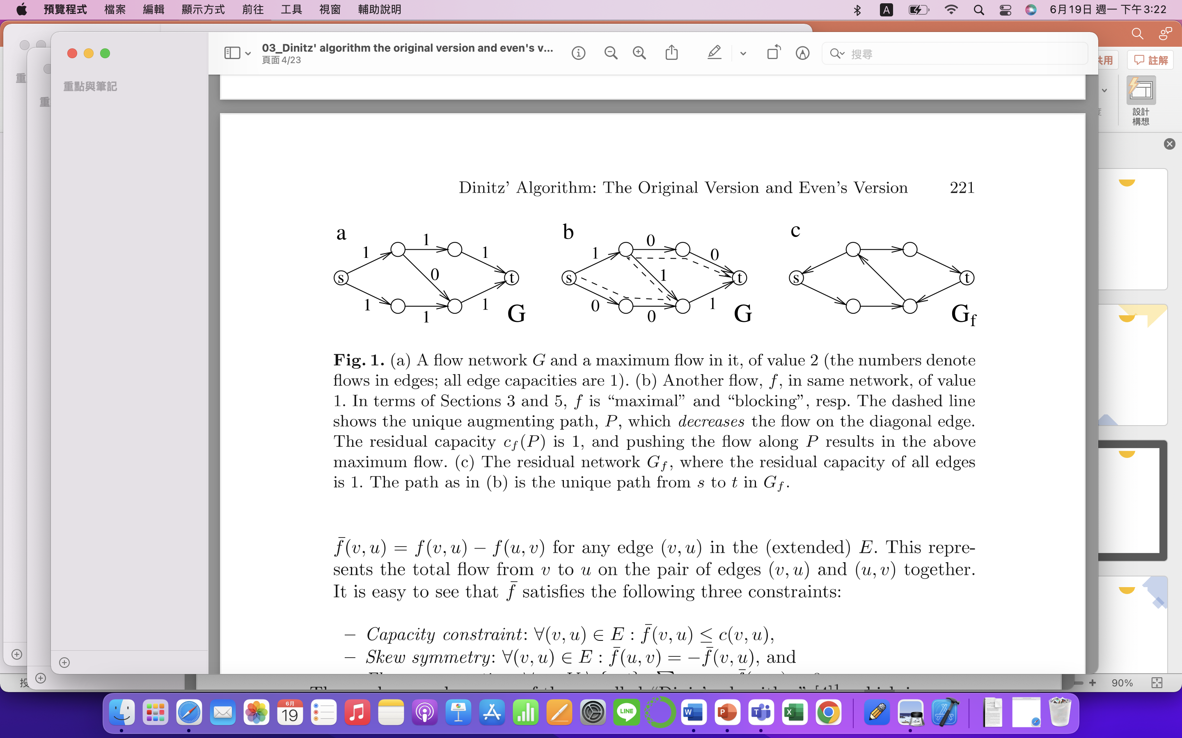
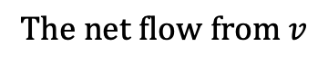
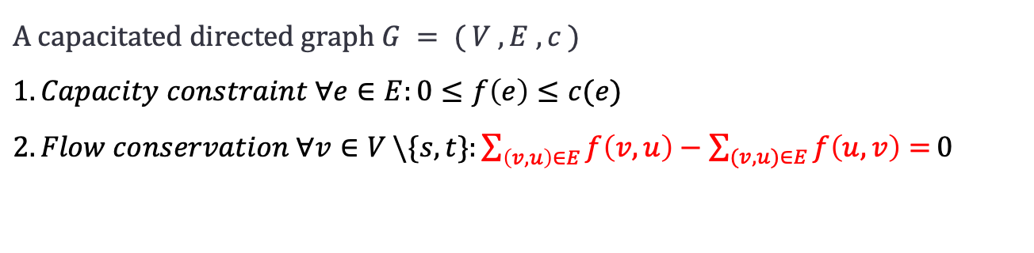
Max flow /Ford&Fulkerson’s Algorithm/Dinitz Algorithm/ Compare/Implementation of DA by Cherkassky/ Further
$A capacitated directed graph G = ( V , E , c )$
$1. Capacity constraint ∀e∈E:0≤f\left(e\right)≤c(e)$
$2. Flow conservation ∀v∈V \backslash \{s,t\}:\sum_{\left(v,u\right)∈E}{f\left(v,u\right)}−\sum_{(v,u)∈E}{f\left(u,v\right)=}0$
$$The net flow from v$$

Slide 4
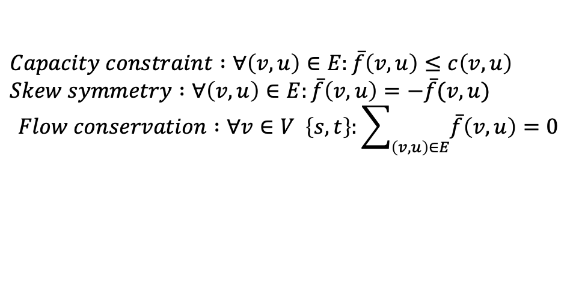
Max flow /Ford&Fulkerson’s Algorithm/Dinitz Algorithm/ Compare/Implementation of DA by Cherkassky/ Further
The dashed line shows the unique augmenting path , P ,which decreases the flow on the diagonal edge .
$Capacity constraint :∀\left(v,u\right)∈E:\overline{f}\left(v,u\right)≤c\left(v,u\right)$
$Skew symmetry :∀\left(v,u\right)∈E:\overline{f}\left(v,u\right)=−\overline{f}(v,u)$
$$Flow conservation :∀v∈V \left\{s,t\right\}:\sum_{\left(v,u\right)∈E}{\overline{f}\left(v,u\right)}=0$$

Slide 5
Ford&Fulkerson’s Algorithm

Slide 6
Max flow /Ford&Fulkerson’s Algorithm/Dinitz Algorithm/ Compare/Implementation of DA by Cherkassky/ Further
1. Initialization:
Construct the initial layered network L(s), which includes all the shortest paths from s to other nodes.
2. Extended BFS (Breadth-First Search):
Construct the layered network L(s, t) by executing the extended BFS algorithm based on L(s), where t is the target node.
3. Network Maintenance:
Given a flow network G and its flow f, maintain the structure of the layered network by building L(s, t). This maintenance process ensures that L(s, t) maintains the properties of shortest paths.
4. Iterative Execution:
Repeat the network maintenance and augmenting path finding process until no more augmenting paths can be found. Each iteration is called a "phase.

Slide 7
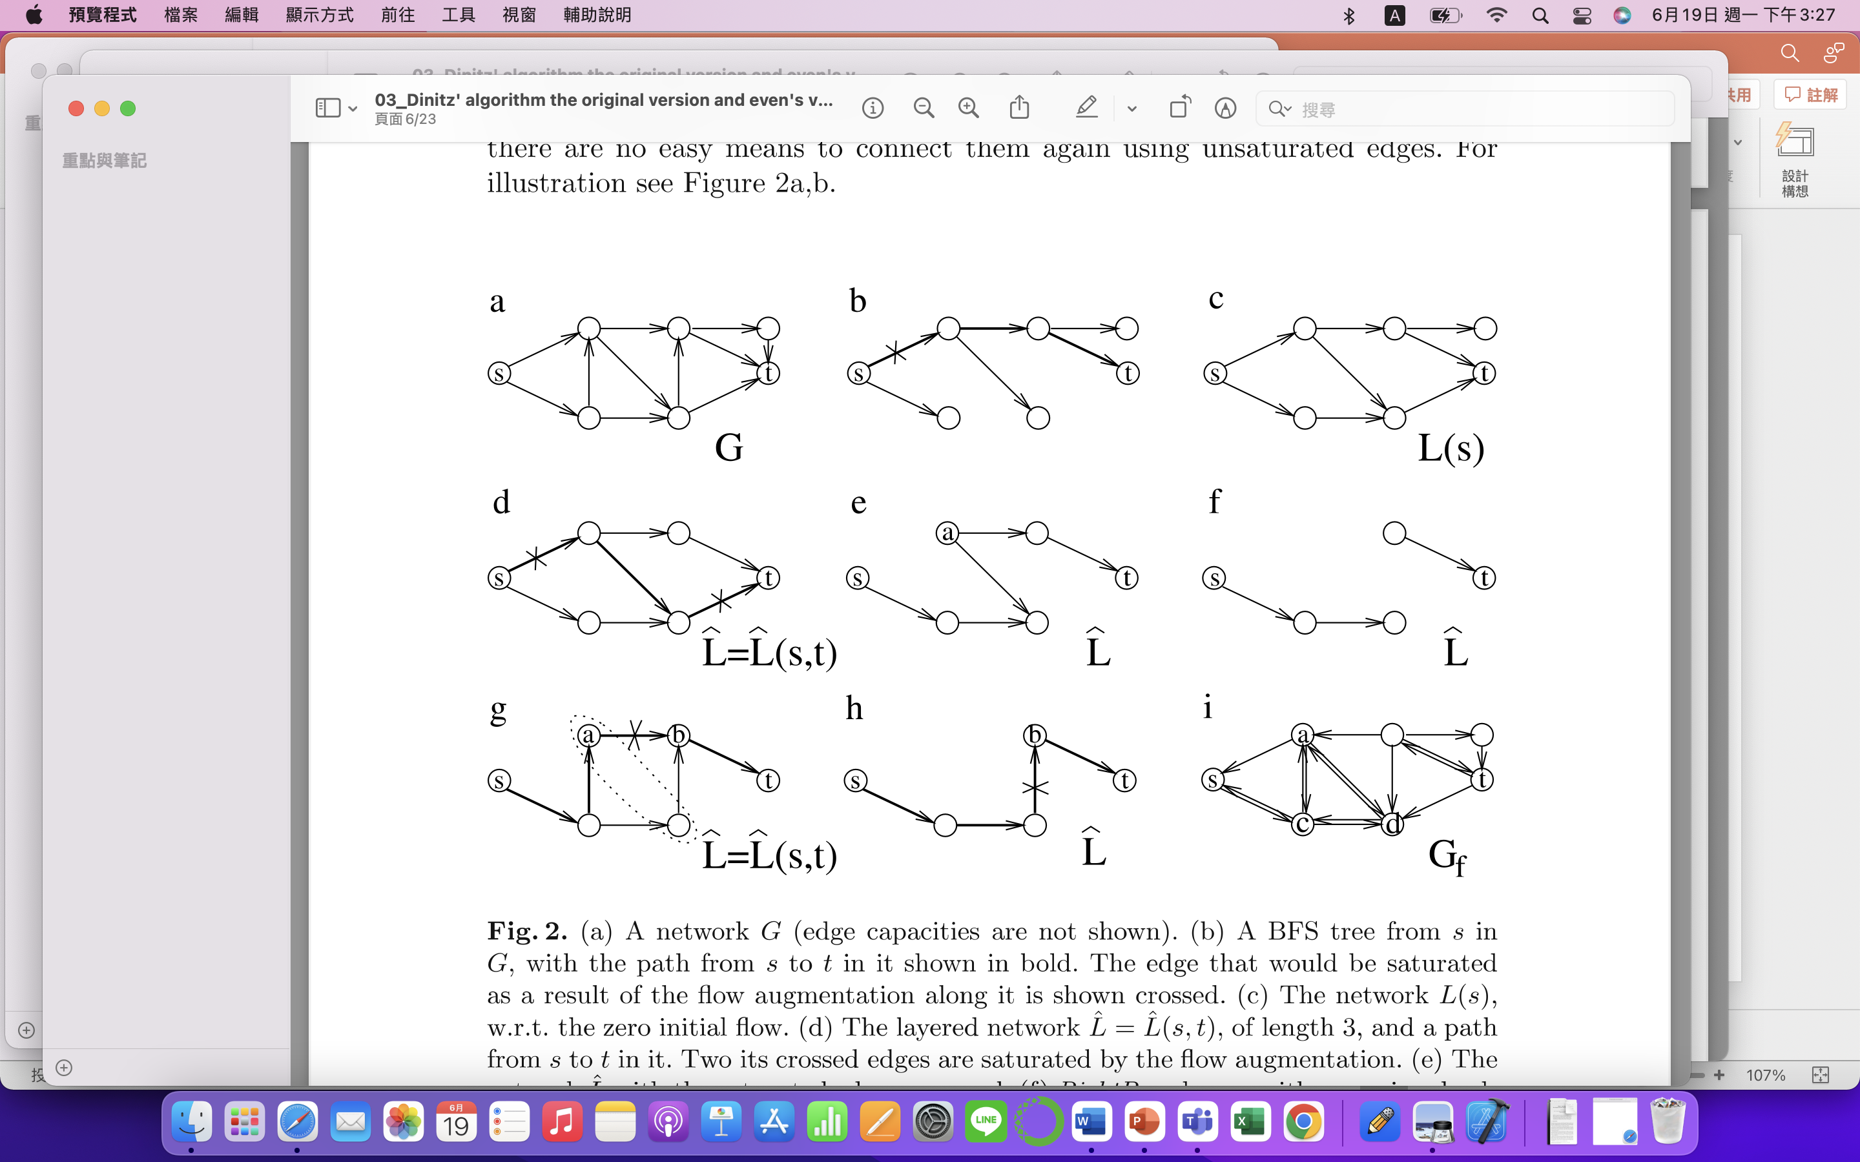
Max flow /Ford&Fulkerson’s Algorithm/Dinitz Algorithm/ Compare/Implementation of DA by Cherkassky/ Further
b. The path from s to t is shown in bold, and the edge that would be saturated as a result of the flow augmentation along it is shown crossed.
d. The layered network L = L ( s , t ) , of length 3 , and a path from s to t in it . Two its crossed edges are saturated by the flow augmentation .

Slide 8
Max flow /Ford&Fulkerson’s Algorithm/Dinitz Algorithm/ Compare/Implementation of DA by Cherkassky/ Further
g. The flow augmentation along the path shown in bold saturates the crossed edge . Vertex a will be cleaned from L.
i. BFS execution in G , marks as reachable from s vertices s , a , c , and d , but not t .

Slide 9
Dinitz Algorithm

Slide 10
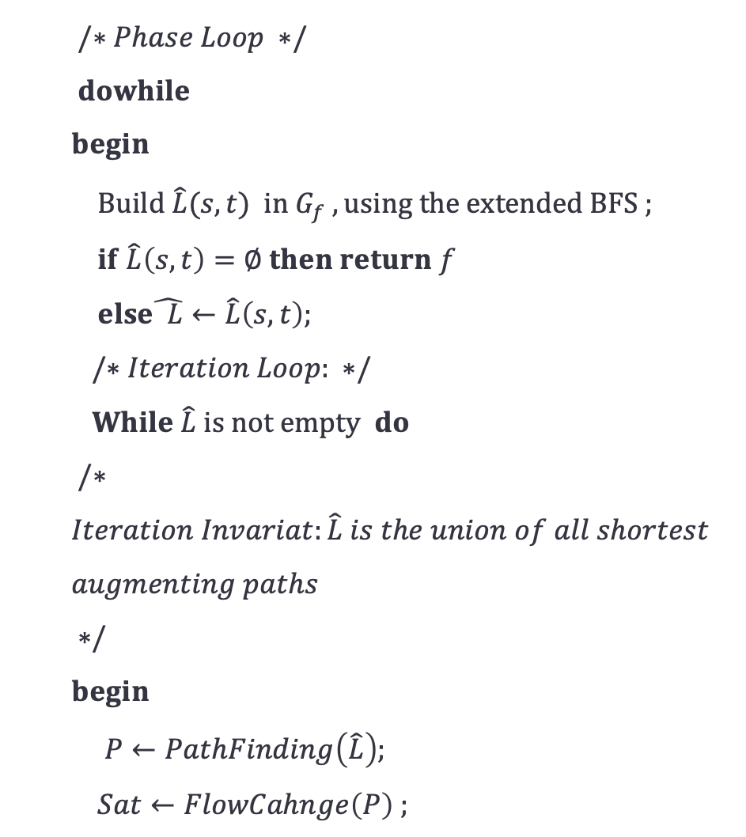
Max flow /Ford&Fulkerson’s Algorithm/Dinitz Algorithm/ Compare/Implementation of DA by Cherkassky/ Further
$/∗Phase Loop ∗/$
$dowhile$
$begin$
$Build \hat{L}(s,t) in G_{f} , using the extended BFS ;$
$if \hat{L}\left(s,t\right)=∅ then return f$
$else\hat{ L}←\hat{L}\left(s,t\right);$
$/∗Iteration Loop: ∗/$
$While \hat{L} is not empty do$
$/∗$
$Iteration Invariat:\hat{L} is the union of all shortest$
$augmenting paths$
$∗/$
$begin$
$P←PathFinding\left(\hat{L}\right);$
$Sat←FlowCahnge\left(P\right) ;$

Slide 11
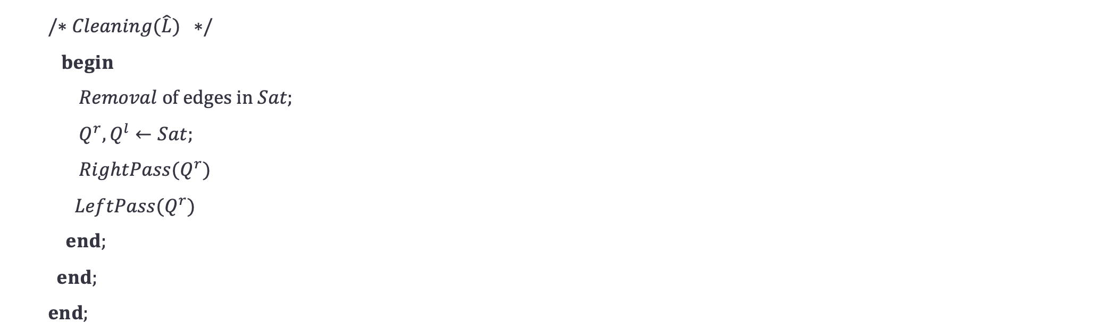
Max flow /Ford&Fulkerson’s Algorithm/Dinitz Algorithm/ Compare/Implementation of DA by Cherkassky/ Further
$/∗Cleaning(\hat{L}) ∗/$
$begin$
$Removal of edges in Sat;$
$Q^{r},Q^{l}←Sat;$
${RightPass(Q}^{r})$
${LeftPass(Q}^{r})$
$end;$
$end;$
$end;$

Slide 12
Max flow /Ford&Fulkerson’s Algorithm/Dinitz Algorithm/ Compare/Implementation of DA by Cherkassky/ Further
DA consists of multiple phases, each phase containing a series of iterations that use shortest augmenting paths of fixed length to modify the flow.
At the beginning of each phase, a layered network data structure of length f is constructed in O(E) time using an extended breadth-first search (BFS).
During a phase, the layered network is continuously maintained as the union of all shortest augmenting paths of length f until it disappears completely, which takes a total of O(E) time.
The structure of the layered network, along with the absence of dead ends, allows each iteration of the Ford-Fulkerson algorithm to be executed in O(|V|) time. The number of iterations in each phase is limited by E.
The running time of DA is O(V^2E).

Slide 13
Compare

Slide 14
Max flow /Ford&Fulkerson’s Algorithm/Dinitz Algorithm/ Compare/Implementation of DA by Cherkassky/ Further
 | FF | DA
Path selection | shortest augmenting path | layered network
Network maintenance | The network is maintained by marking the used edges to trace the augmenting path | A layered network is used to maintain the paths
Definition of running time | The running time depends on the choice of augmenting paths | The running time of each phase is fixed due to the use of layered networks

Slide 15
Implementation of DA by Cherkassky

Slide 16
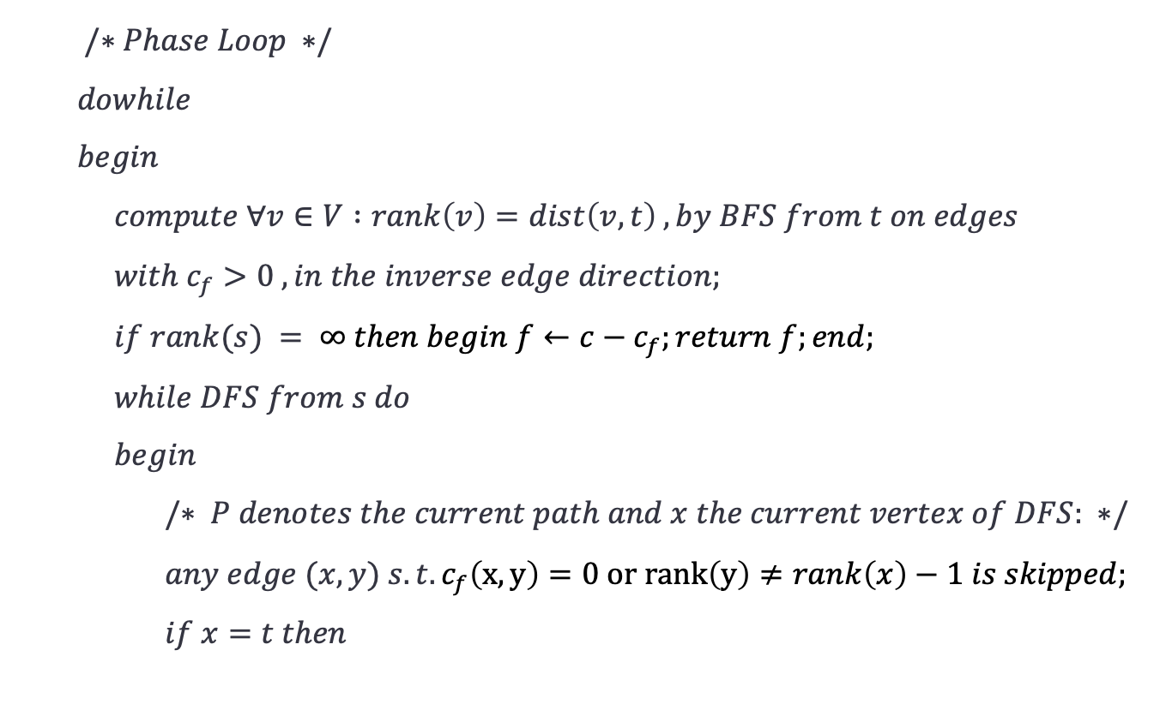
Max flow /Ford&Fulkerson’s Algorithm/Dinitz Algorithm/ Compare/Implementation of DA by Cherkassky/ Further
$/∗Phase Loop ∗/$
$dowhile$
$begin$
$compute ∀v∈V :rank\left(v\right)=dist\left(v,t\right) , by BFS from t on edges$ $with c_{f}>0 , in the inverse edge direction;$
$if rank(s) = ∞ then begin f←c−c_{f};return f;end;$
$while DFS from s do$
$begin$
$/∗ P denotes the current path and x the current vertex of DFS: ∗/$
$any edge (x,y) s.t. c_{f}\left(x,y\right)=0 or rank\left(y\right)≠rank\left(x\right)−1 is skipped;$
$if x=t then$

Slide 17
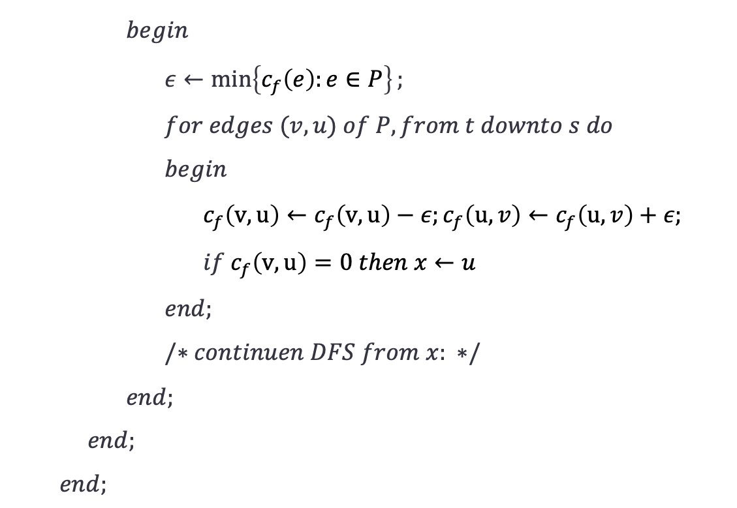
Max flow /Ford&Fulkerson’s Algorithm/Dinitz Algorithm/ Compare/Implementation of DA by Cherkassky/ Further
$begin$
$ε←\min\left\{c_{f}\left(e\right):e∈P\right\};$
$for edges (v,u) of P, from t downto s do$
$begin$
$c_{f}\left(v,u\right)←c_{f}\left(v,u\right)−ε;c_{f}\left(u,v\right)←c_{f}\left(u,v\right)+ε;$
$if c_{f}\left(v,u\right)=0 then x←u$
$end;$
$/∗continuen DFS from x: ∗/$
$end;$
$end;$
$end;$

Slide 18
Max flow /Ford&Fulkerson’s Algorithm/Dinitz Algorithm/ Compare/Implementation of DA by Cherkassky/ Further
1. No need for constructing layered networks:
Cherkassky suggests that there is no need to construct layered networks L(s) or L(s, t).
2. Single DFS traversal:
The entire phase only requires a single DFS traversal starting from the source node s.
3. No need to remove edges:
If the DFS backtracks to a certain edge, that edge will not automatically participate in the remaining part of the DFS traversal.

Slide 19
On the Further Progress of Max - Flow Finding

Slide 20
Max flow /Ford&Fulkerson’s Algorithm/Dinitz Algorithm/ Compare/Implementation of DA by Cherkassky/ Further
Edmonds and Karp: Edmonds and Karp developed a version of the Ford-Fulkerson (FF) algorithm. Their algorithm uses shortest augmenting paths and achieves a time complexity of O(V³), which is higher than the O(VIE) complexity of the original FF algorithm.
Running time of DA for Special Cases: The running time of DA was studied for specific network types. It was shown that for networks with unit capacities, each phase of DA can be executed in O(E) time, resulting in a total running time of O(V||E|).
Karzanov's Algorithm: Karzanov introduced the "preflow-push" method, which can find a blocking flow in O(V²) time.
Improvements upon DA and KA: Researchers made efforts to lower the running time of maximum flow algorithms.

Slide 21
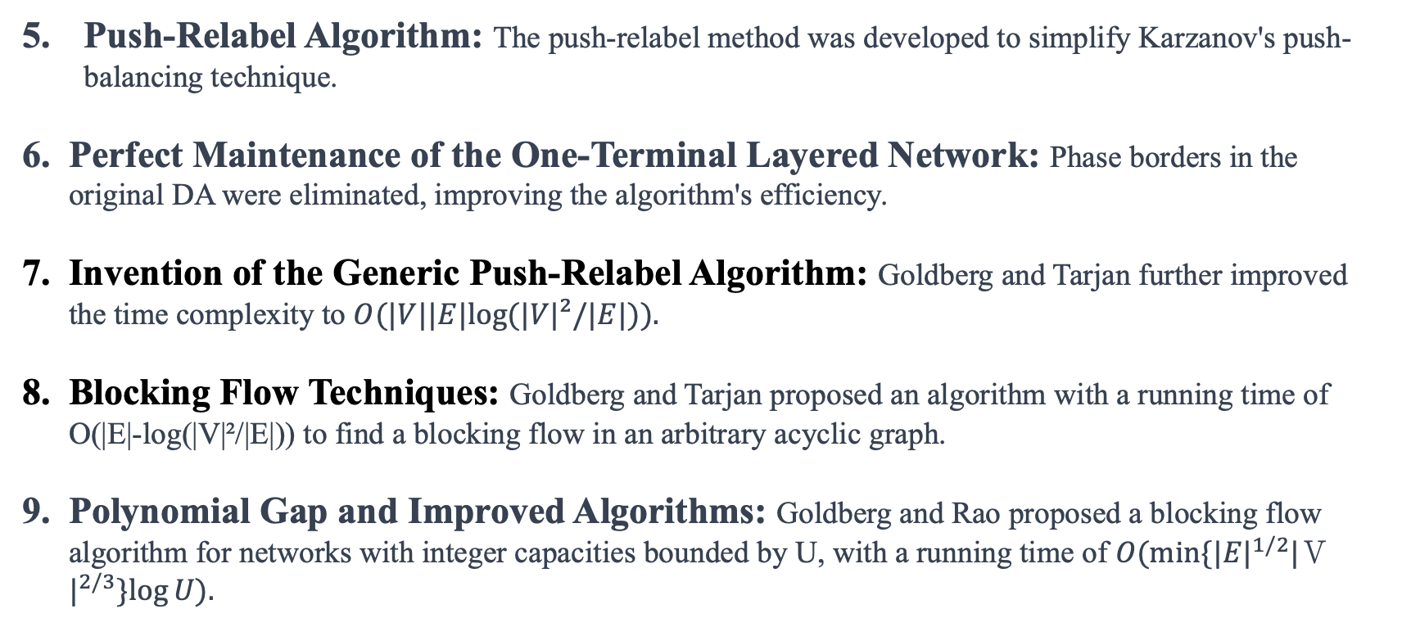
Max flow /Ford&Fulkerson’s Algorithm/Dinitz Algorithm/ Compare/Implementation of DA by Cherkassky/ Further
Push-Relabel Algorithm: The push-relabel method was developed to simplify Karzanov's push-balancing technique.
Perfect Maintenance of the One-Terminal Layered Network: Phase borders in the original DA were eliminated, improving the algorithm's efficiency.
Invention of the Generic Push-Relabel Algorithm: Goldberg and Tarjan further improved the time complexity to $O(|V||E|log⁡(|V|²/|E|)).$
Blocking Flow Techniques: Goldberg and Tarjan proposed an algorithm with a running time of O(|E|-log(|V|²/|E|)) to find a blocking flow in an arbitrary acyclic graph.
Polynomial Gap and Improved Algorithms: Goldberg and Rao proposed a blocking flow algorithm for networks with integer capacities bounded by U, with a running time of $O(min⁡\{{|E|}^{1/2}{|Ｖ|}^{2/3}\}log⁡U).$

Slide 22
The end

